Slide 1
Regression Analysis
Logistic Regression
Nicoleta Serban, Ph.D.
Professor
Stewart School of Industrial and Systems Engineering
Goodness of Fit Assessment:
Data Examples

Slide 2

About This Lesson

Slide 3
Data Example: Smoking
Between 1972 and 1974, a survey was taken in Whickham, a mixed urban and rural district near Newcastle upon Tyne, United Kingdom.
  Among the information obtained originally was whether a person was a smoker or not.
Twenty years later a follow-up study was conducted.
  76.12% of the 582 smokers were still alive, while only 68.58% of 732 nonsmokers were still alive.
Smokers had a higher survival rate than nonsmokers!
Call Philip Morris, smoking leads to a longer life span!
Acknowledgement: This example was provided by Dr. Jeffrey Simonoff from New York University.

Slide 4
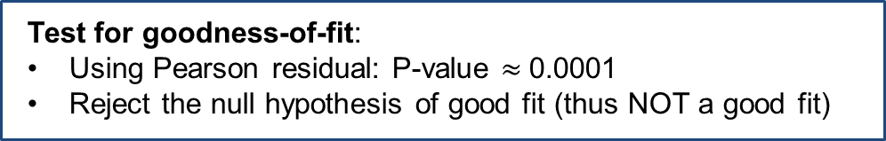

GOF Hypothesis Test
## Deviance Test for GOF using deviance residuals
c(deviance(smoke2), 1-pchisq(deviance(smoke2),11))
[1] 4.345918e+01 9.033325e-06
## GOF test using Pearson residuals
pearres2 = residuals(smoke2,type="pearson")
pearson.tvalue = sum(pearres2^2)
c(pearson.tvalue, 1-pchisq(pearson.tvalue,11))
[1] 36.751889370 0.000126796
Test for goodness-of-fit:
Using deviance residuals: P-value $≈$ 0
Reject the null hypothesis of good fit (thus NOT a good fit)
Test for goodness-of-fit:
Using Pearson residual: P-value $≈$0.0001
Reject the null hypothesis of good fit (thus NOT a good fit)

Slide 5
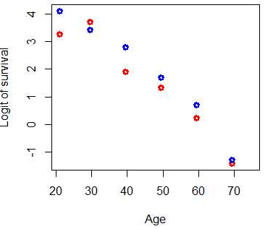
Linearity Assumption
## Is it a linear fit?
plot(Age,log((Survived/At.risk)/(1-Survived/At.risk)), ylab="Logit of survival", main="Scatterplot of logit survival rate vs age", col=c("red","blue"), lwd=3)
The relationship between the logit of survival and age is more quadratic than linear.

Slide 6
Improve the Fit
## Fit a logistic regression model
Age.squared = Age*Age
smoke3 = glm(Survived/At.risk ~ Smoker + Age + Age.squared, weights=At.risk, family=binomial)
summary(smoke3)
Coefficients:
Null deviance: 641.496 on 13 degrees of freedom
Residual deviance: 19.808 on 10 degrees of freedom
 | Estimate | Std. Error | z value | Pr(>|z|)
(Intercept) | 2.5190783 | 1.0248206 | 2.458 | 0.0140 *
Smoker | -0.4284561 | 0.1770581 | -2.420 | 0.0155 *
Age | 0.0951102 | 0.0430095 | 2.211 | 0.0270 *
Age.squared | -0.0021673 | 0.0004309 | -5.030 | 4.91e-07 ***
Test for significance: $β_{smoker}$P-value $≈$ 0.015, statistically significant at 0.05
Test for significance: $β_{Age.squared}$P-value $≈$ 0, statistically significant

Slide 7
GOF Test for Improved Model
## Test for goodness of fit
round(c(deviance(smoke3), 1-pchisq(deviance(smoke3),10)),2)
[1] 19.81 0.03
pearres3 = residuals(smoke3,type="pearson")
pearson = sum(pearres3^2)
round(c(pearson, 1-pchisq(pearson,10)),2)
[1] 14.79 0.14
Does the goodness of fit improve?
Using deviance residuals: P-value = 0.03
Using Pearson residual: P-value = 0.14
Do not reject the null hypothesis of good fit using Pearson residuals, but do reject using Deviance residuals at the significance level 0.03 or higher.

Slide 8
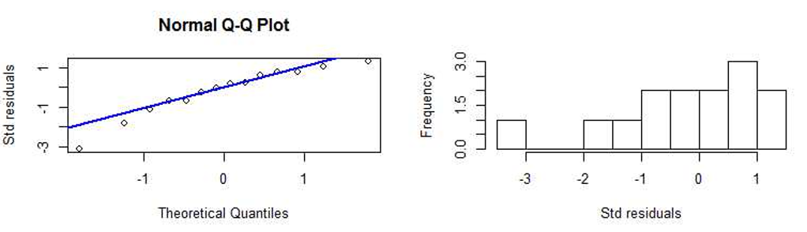
Residual Analysis
## Residual Plots
res = resid(smoke3,type="deviance")
qqnorm(res, ylab="Std residuals")
qqline(res,col="blue",lwd=2)
hist(res,10,xlab="Std residuals", main="")

Slide 9
Higher Order Nonlinearity
## Fit a logistic regression model with Age as a factor
smoke4 = glm(Survived/At.risk ~ Smoker + factor(Age), weights=At.risk, family=binomial)
summary(smoke4)
Coefficients:
Null deviance: 641.4963 on 13 degrees of freedom
Residual deviance: 2.3809 on 6 degrees of freedom
 | Estimate | Std. Error | z value | Pr(>|z|)
(Intercept) | 3.8601 | 0.5939 | 6.500 | 8.05e-11 ***
Smoker | -0.4274 | 0.1770 | -2.414 | 0.015762 *
factor(Age)29.5 | -0.1201 | 0.6865 | -0.175 | 0.861178
factor(Age)39.5 | -1.3411 | 0.6286 | -2.134 | 0.032874 *
factor(Age)49.5 | -2.1134 | 0.6121 | -3.453 | 0.000555 ***
factor(Age)59.5 | -3.1808 | 0.6006 | -5.296 | 1.18e-07 ***
factor(Age)69.5 | -5.0880 | 0.6195 | -8.213 | < 2e-16 ***
factor(Age)75 | -27.8073 | 11293.1437 | -0.002 | 0.998035

Slide 10
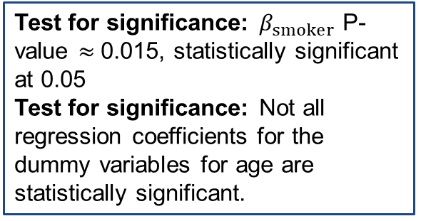
Higher Order Nonlinearity
## Fit a logistic regression model with Age as a factor
smoke4 = glm(Survived/At.risk ~ Smoker + factor(Age), weights=At.risk, family=binomial)
summary(smoke4)
Coefficients:
Null deviance: 641.4963 on 13 degrees of freedom
Residual deviance: 2.3809 on 6 degrees of freedom
 | Estimate | Std. Error | z value | Pr(>|z|)
(Intercept) | 3.8601 | 0.5939 | 6.500 | 8.05e-11 ***
Smoker | -0.4274 | 0.1770 | -2.414 | 0.015762 *
factor(Age)29.5 | -0.1201 | 0.6865 | -0.175 | 0.861178
factor(Age)39.5 | -1.3411 | 0.6286 | -2.134 | 0.032874 *
factor(Age)49.5 | -2.1134 | 0.6121 | -3.453 | 0.000555 ***
factor(Age)59.5 | -3.1808 | 0.6006 | -5.296 | 1.18e-07 ***
factor(Age)69.5 | -5.0880 | 0.6195 | -8.213 | < 2e-16 ***
factor(Age)75 | -27.8073 | 11293.1437 | -0.002 | 0.998035
Test for significance: $β_{smoker}$ P-value $≈$0.015, statistically significant at 0.05
Test for significance: Not all regression coefficients for the dummy variables for age are statistically significant.

Slide 11
Higher Order Nonlinearity: GOF
## Test for goodness of fit
round(c(deviance(smoke4), 1-pchisq(deviance(smoke4),6)),2)
[1] 2.38 0.88
pearres4 = residuals(smoke4,type="pearson")
pearson = sum(pearres4^2)
round(c(pearson, 1-pchisq(pearson,6)),2)
[1] 2.37 0.88
Does the goodness of fit improve?
Using deviance residuals: P-value = 0.88
Using Pearson residual: P-value = 0.88
Do not reject the null hypothesis of good fit using either Pearson residuals or Deviance residuals.

Slide 12
Different Link Function
## Use probit link function
smoke5 = glm(Survived/At.risk ~ Smoker + Age + Age.squared, weights=At.risk, family=binomial(link = probit))
summary(smoke5)
Coefficients:
Null deviance: 641.496 on 13 degrees of freedom
Residual deviance: 18.233 on 10 degrees of freedom
 | Estimate | Std. Error | z value | Pr(>|z|)
(Intercept) | 1.1033963 | 0.4904877 | 2.250 | 0.02447 *
Smoker | -0.2277451 | 0.0970191 | -2.347 | 0.01890 *
Age | 0.0681279 | 0.0213095 | 3.197 | 0.00139 **
Age.squared | -0.0013767 | 0.0002173 | -6.335 | 2.37e-10 ***
Test for significance: $β_{smoker}$P-value $≈$ 0.018, statistically significant at 0.05
Test for significance: $β_{Age.squared}$P-value $≈$ 0, statistically significant

Slide 13
Different Link Function: GOF
## Test for goodness of fit
round(c(deviance(smoke5), 1-pchisq(deviance(smoke5),10)),2)
[1] 18.23 0.05
pearres5 = residuals(smoke5,type="pearson")
pearson = sum(pearres5^2)
round(c(pearson, 1-pchisq(pearson,10)),2)
[1] 14.00 0.17
Does the goodness of fit improve?
Using deviance residuals: P-value = 0.05
Using Pearson residual: P-value = 0.17
Do not reject the null hypothesis of good fit using Pearson residuals or using deviance residuals at the significance level 0.01.

Slide 14
Simpson’s Paradox
Simpson’s paradox: Reversal of an association when looking at a marginal relationship versus a conditional relationship.
  Smoking is statistically significant with a positive estimated coefficient under the marginal model.
  Smoking has a negative estimated coefficient under the conditional model.
Marginal versus Conditional Relationship
  Marginal: Capturing the association of a predicting variable to the response variable without consideration of other factors
  Conditional: Capturing the association of a predicting variable to the response variable conditional on other predicting variables in the model

Slide 15

Summary

